Slide 1
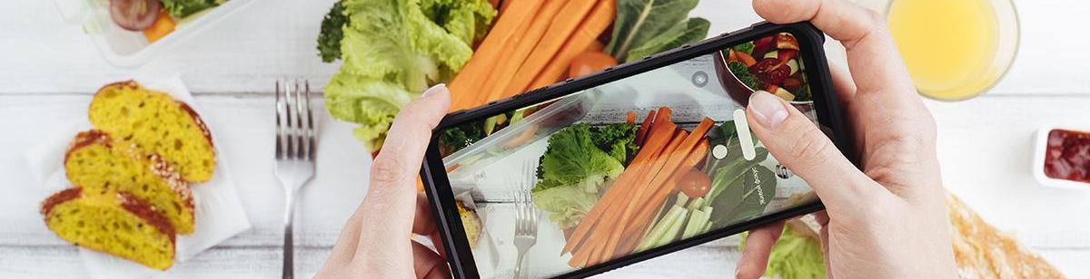
KrogerWhat!? App
Victor Sim, Tan Vo, Shang-Kai Wen, Christian Galvez

Slide 2
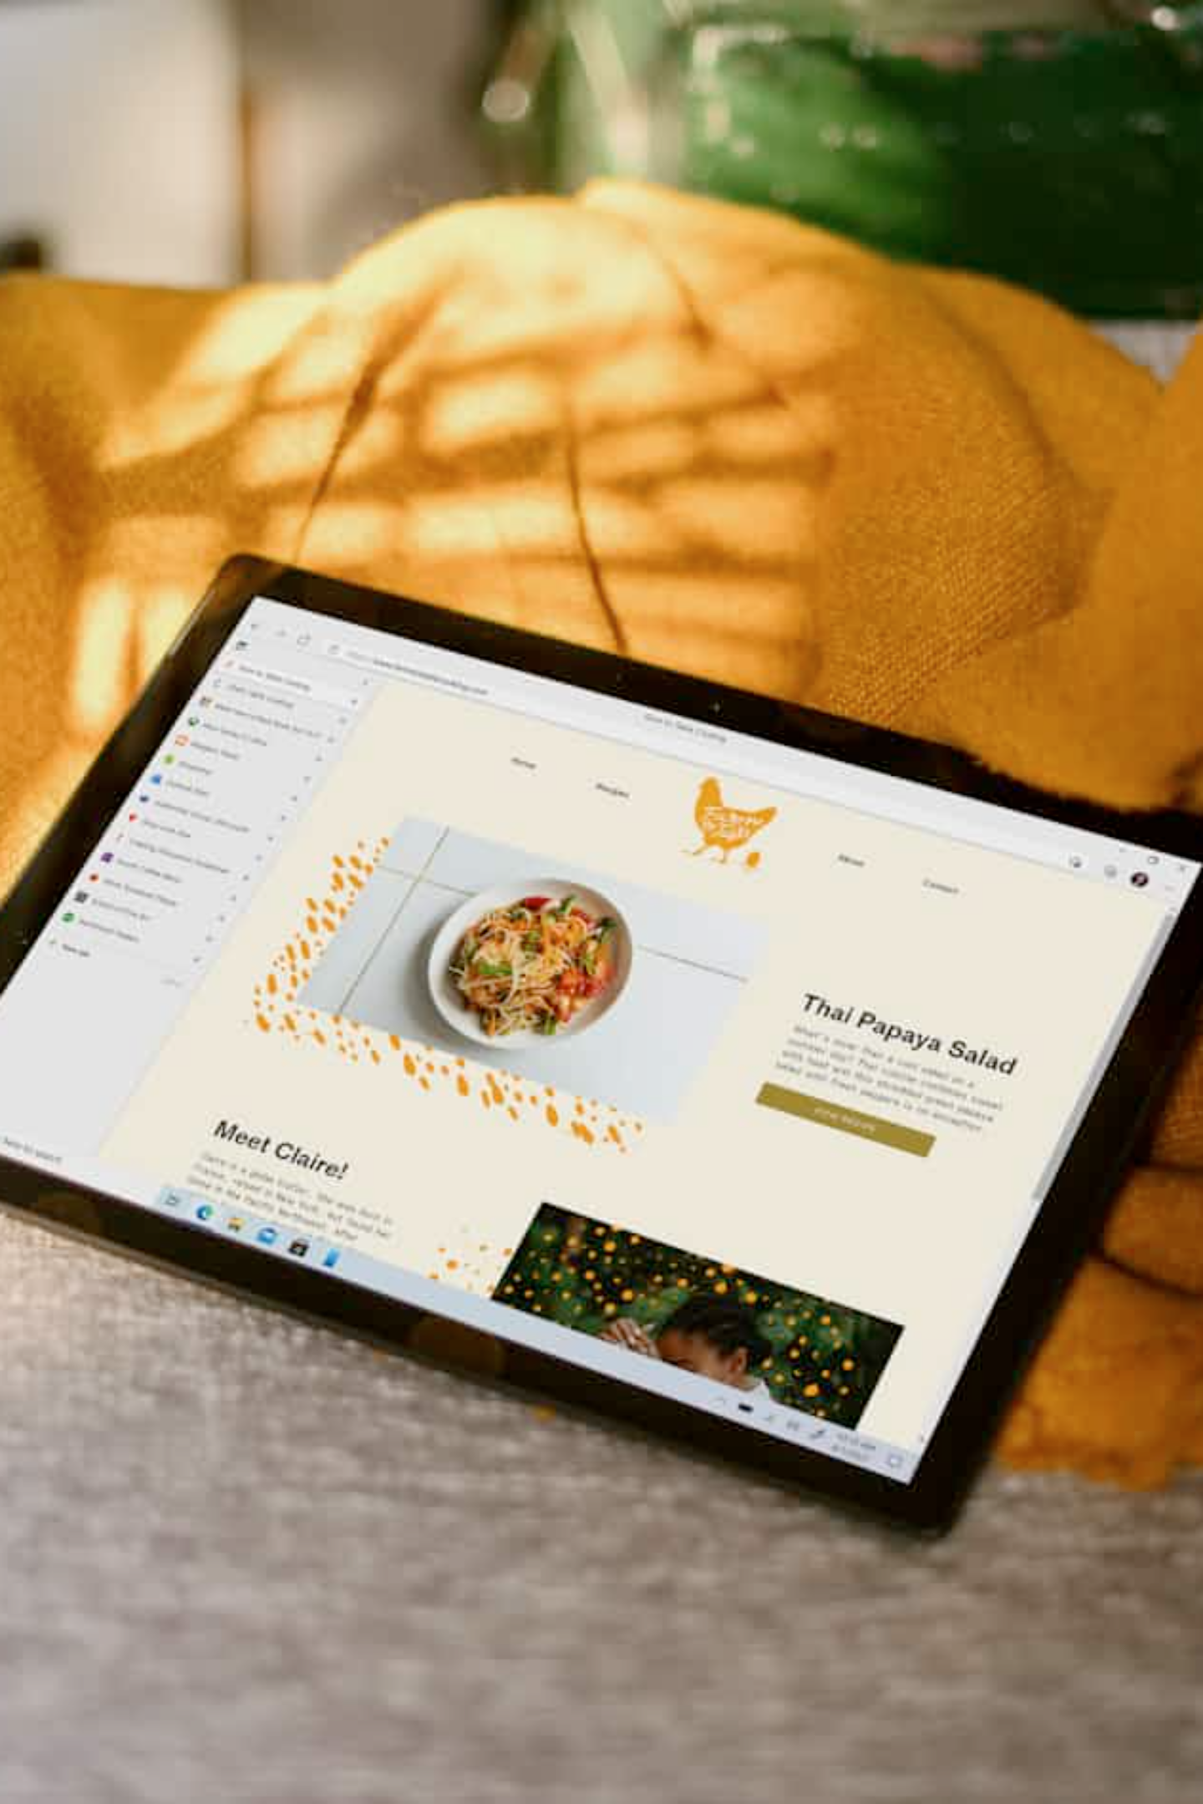
Table of Contents
01
App Overview - Description and evaluation of the app concept
02
Product Spec - User features, APIs, and interaction details
03
Wireframes - Visual design mockups
04
Build Notes - Development progress and prototypes

Slide 3
App Overview
KrogerWhat!? is a fun play off of The Price is Right!
The goal of the game is to correctly guess the higher/lower priced items within the 30 second timeframe, to obtain as high a score as possible.
Category
Mobile
Entertainment
Many users appreciate the simplicity a mobile interface provides. Its elegant button usage allows the user to easily tap away at any choice they so desire. Additionally, users have the added pleasure of bragging to their friends when they hit a new top score.
Story
Market
Historically, the price is right has done very well. So tacking on a NEW Kroger edition™️ to it will make it all the rage!
This app serves double purpose for Kroger fans; they get to learn the latest grocery prices AND have some nice family fun.
Habit
Scope
Within just a few games, a user can quickly find themselves addicted to guessing Kroger prices. It's like gambling, but without having to spend real money.
The main difficulty with creating this app will be in figuring out how to work with the API to get a random selection of products to compare their prices to.

Slide 4
Product Spec
User Features
Required Features:
Stretch Features:
O
Buttons to allow user to select choice - Shang-Kai/Tan Vo/Victor
O
Menu Screen/UI Design - Shang-Kai/Christian/Tan Vo/Victor
O
API calls for product name - Victor
O
API calls for product image - Victor
O
API calls for product price (hidden to user) - Victor
O
Scoring system - Tan Vo/Victor
Chosen API(s)
Kroger Products API
Get product name
Get product price
Get product image
Get product category

Slide 5


User Interaction
Required Feature
Button choice - Tan Vo, Victor
Multiple products - Tan Vo
If in menu, starts the game
Player can see and interact with multiple product choices (can scroll if needed - Recycler view)
If in game, locks in player's choice of item that is higher/less priced
If in menu, you can reset your score.

Slide 6
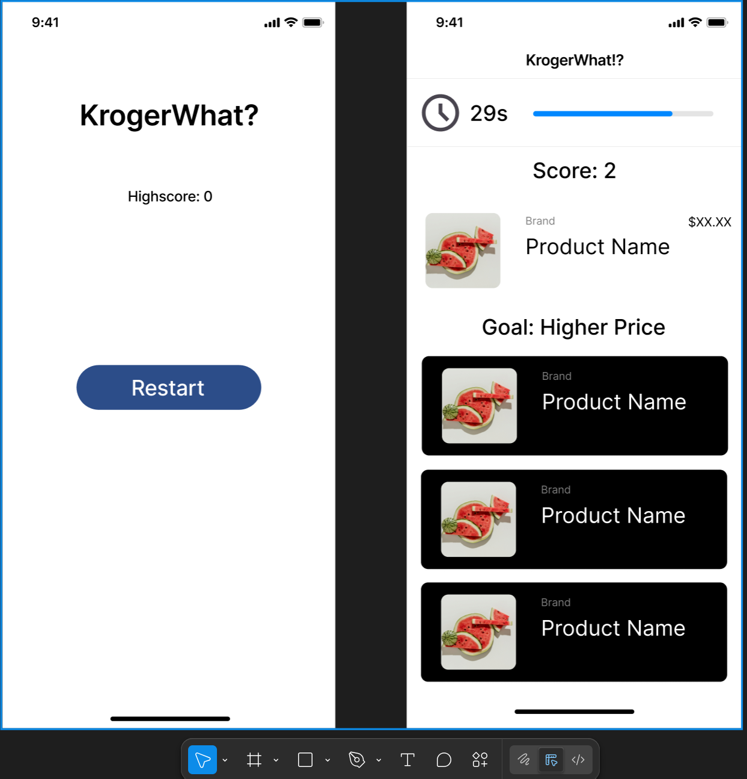
Wireframes
Main
Game

Slide 7
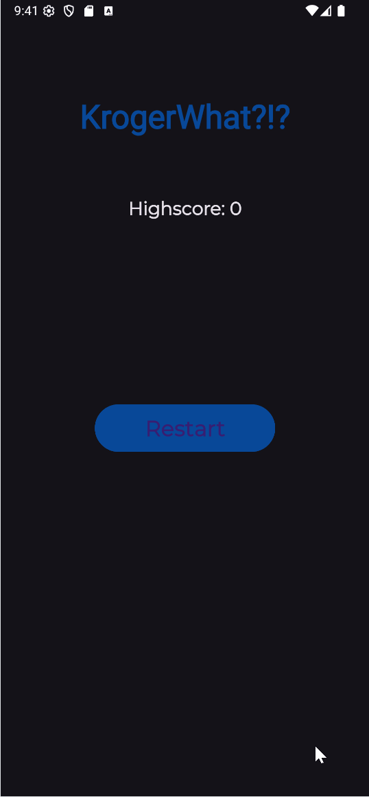
Build V1
The following is our first prototype of the app. In this version, API calls have not been made yet, but we laid the groundworks for basic game functionality.

Slide 8
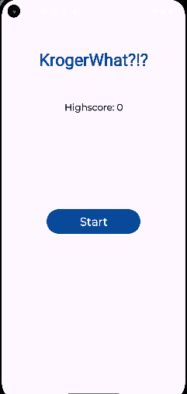
Build V2
Victor was able to discover a way to call the API. However, this version had significant latency issues that still needed debugging.

Slide 9
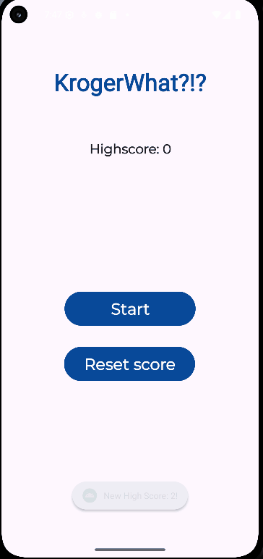
Final Build
The latency issue was fixed; KrogerWhat!? was now able to be officially released!
Latency was resolved by prefetching data (still sourced from the Kroger API) into a local JSON.

Slide 10
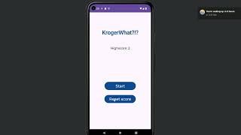
Demo Video
https://www.youtube.com/watch?v=VIVdtp3q4kE

Slide 11
Possible Improvements
Could make rounds with curated/specific product categories
Could expand to different grocery stores
Recyclerview can have more options to choose from
Could have an in-app search feature for certain items
UI can be upgraded to be more game-like
Could add a leaderboard
Could add more/smarter unit tests, error handling, better architecture, and optimization via refactoring.

Slide 12
License
Copyright 2025 Victor Sim, Christian Galvez, Tan Vo, Shang-Kai Wen
Licensed under the Apache License, Version 2.0 (the "License"); you may not use this file except in compliance with the License. You may obtain a copy of the License at
http://www.apache.org/licenses/LICENSE-2.0
Unless required by applicable law or agreed to in writing, software distributed under the License is distributed on an "AS IS" BASIS, WITHOUT WARRANTIES OR CONDITIONS OF ANY KIND, either express or implied. See the License for the specific language governing permissions and limitations under the License.

